Slide 1
Model Validation Metrics
Confusion Matrix
What percent of your predictions were correct? You answer: the "accuracy" was (9,760+60) out of 10,000 = 98.2%
Precision and Recall
 | Predicted Negative (or 0) | Predicted Positive(or 1)
Negative (or 0) cases | TN:9760 | FP:140
Positive (or 1) Cases | FN:40 | TP:60

Slide 2
Precision & Recall
What is Precision? What is Recall?
What percent of the positive cases did you catch? You answer: the "recall" was 60 out of 100 = 60%
What percent of positive predictions were correct? You answer: the "precision" was 60 out of 200 = 30%
 | Predicted Negative (or 0) | Predicted Positive(or 1)
Negative (or 0) cases | TN:9760 | FP:140
Positive (or 1) Cases | FN:40 | TP:60

Slide 3
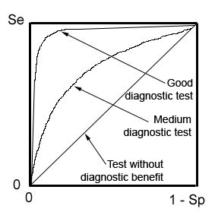
ROC Curve
Receiver Operating Characteristic curve (or ROC curve) is a plot of the true positive rate against the false positive rate and illustrates the performance of a binary classifier system
An ROC curve demonstrates several things:
The closer the curve follows the left-hand border and then the top border of the ROC space, the more accurate the test.
The closer the curve comes to the 45-degree diagonal of the ROC space, the less accurate the test.
The area under the curve is a measure of accuracy.
Se = Sensitivity = True positive
Sp = Specificity
1-Sp = False positive

Slide 4
Problem of Class Imbalance
Many times, one of the class may be much higher in number than the other
Solution: Resampling. Under sample the overrepresented class

